Slide 1
CSEN20
Fall 2026
Introduction to Embedded Systems
Michael Schimpf, PhD, mschimpf@scu.edu

Slide 2
Chapter 5 Integer Arithmetic
Part 1: Addition and Subtraction

Slide 3


ADDITION AND SUBTRACTION
Unsigned
3
+10
13₁₀
Binary
0011
+1010
1101₂
2’s Complement
(+3)
+(-6)
-3₁₀
A single ADD (or SUB) instruction works for both unsigned and 2’s comp.

Slide 4
FLAGS Current Program Status Register (APSR)
This subset is the Application Processor Status Register (APSR)
31
30
29
28
27
26
0
N
Z
C
V
reserved
Overflow during addition:
Unsigned: C flag = 1
2’s Comp: V flag = 1
Overflow flag: A value of 1 indicates a 2’s complement overflow during an addition, subtraction or compare.
Carry flag: A value of 1 indicates a carry out during addition.
Overflow during subtraction:
Unsigned: C flag = 0
2’s Comp: V flag = 1
Zero flag: A value of 1 indicates a result (or difference) of zero
Negative flag: A value of 1 indicates a negative result

Slide 5
ADD AND SUBTRACT INSTRUCTIONS
Instruction | Format | Operation | Flags
Add | ADD{S} Rd,Rn,Op2 | Rd = Rn + Op2 | N,Z,C,V
Add with Carry | ADC{S} Rd,Rn,Op2 | Rd = Rn + Op2 + Carry | N,Z,C,V
Subtract | SUB{S} Rd,Rn,Op2 | Rd = Rn − Op2 | N,Z,C,V
Subtract with Carry | SBC{S} Rd,Rn,Op2 | Rd = Rn − Op2 − ~Carry | N,Z,C,V
Reverse Subtract | RSB{S} Rd,Rn,Op2 | Rd = Op2 − Rn | N,Z,C,V
"Op2" may only be a constant, a register, or a shifted register.
"S" must be appended to affect the flags!

Slide 6
MULTIPLE-PRECISION ADDITION
// int64_t Add64(int64_t num1, int64_t num2) ; .global Add64 .align .thumb_func Add64: ADDS R0,R0,R2 // R0 = sum bits 31-0 ADCS R1,R1,R3 // R1 = sum bits 63-32 BX LR // Return .end
64bit Add
num1
R1
R0
Append "S" to ADD so it will record any carry out.
2nd: ADC
1st: ADDS
num2
R3
R2
Use an ADC so that the carry is included in the second sum.
R1
R0

Slide 7

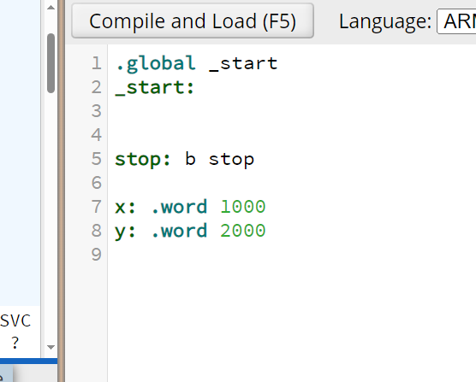
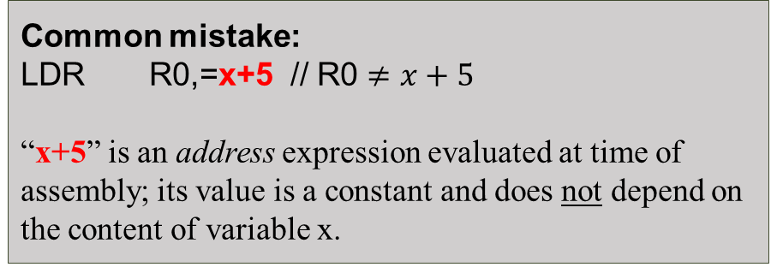
EXAMPLE Implementing y = x + 5 ;
https://cpulator.01xz.net/
LDR R0,=x // R0 <-- &x (get the address of x)
LDR R0,[R0] // R0 <-- x (load the value of what R0 points)
ADD R0,R0,5 // R0 <-- R0 + 5 (add 5)
LDR R1,=y // R1 <-- &y (get the address of y)
STR R0,[R1] // R0 --> y (store R0 to address of y)
Try it with CPULator
Common mistake:
LDR R0,=x+5 // R0 $≠x+5$
“x+5” is an address expression evaluated at time of assembly; its value is a constant and does not depend on the content of variable x.

Slide 8
ARM Thumb-2 Instruction Encodings
Two instruction sizes: 16-bits and 32-bits
Some operations are available in both versions
The assembler always uses a 16-bit version if available

Slide 9
ADD Immediate
ADDS Rd,Rn,imm3
16-bit | 32-bit
Registers R0-R7 3-bit constants "S" required | Registers R0-R15 12-bit constants "S" optional
ADD{S} Rd,Rn,imm12

Slide 10
ADD Register
ADDS Rd,Rn,Rm
16-bit | 32-bit
Registers R0-R7 "S" required Rm not shifted | Registers R0-R15 "S" optional Shifted Rm optional
ADD{S} Rd,Rn,Rm{,shift bits}

Slide 11
Reducing Code Size = Faster Code
Use 16-bit instructions whenever possible.
Most 16-bit instructions require the letter “S”
Always add “S” unless flags must not be changed
Without “S”, instruction will be 32 bits wide!
Use the “narrow” suffix to verify (e.g., ADD.N)
Doesn’t change the instruction, but
Causes error message if there is no 16-bit version

Slide 12
Chapter 5 Integer Arithmetic
Part 2: Multiplication

Slide 13
DECIMAL MULTIPLICATION
9
×999
8,991₁₀
99
×99
9,801₁₀
999
×999
998,001₁₀
The product may require as many digits as the total # of digits!

Slide 14
BINARY MULTIPLICATION
12
×13
156₁₀ =
1100
×1101 1001 1100₂
Product may require as many digits as the total # of digits.
A "double length product" uses the full product width:
2N bits ← N bits × N bits
3
×2
6₁₀ =
0011
×0010
0000 0110₂
A "single length product" keeps only least-significant half: N bits ← N bits × N bits

Slide 15
BINARY MULTIPLICATION
Unsigned
Binary
2’s comp
12
×13
156₁₀
1100
×1101
-4
×-3
+12₁₀
1001 1100₂
0000 1100₂
The signed and unsigned products are different!
Least-significant halves are the same!

Slide 16
MULTIPLICATION IN C
Consider how integer multiplication works in C:
int32_t a, b;
int32_t c;
c = a * b;
uint32_t x, y;
uint32_t z;
z = x * y;
The data type (and size) of the product is the same as operands. Thus: 32 bits × 32 bits → 32 bits.
The result is often stored in a variable of the same type, so a single-length product is sufficient.
int32_t
Since the result is a single-length product, the same instruction can be used for signed and unsigned.

Slide 17
MULTIPLICATION IN C
Consider how integer multiplication works in C:
uint32_t a32, b32;
uint64_t c64;
c64 = a32 * b32;
c64 = a32 * c64;
In C, operator results have the same data type as their operands.
C uses single-length products.
32-bit product
Storing 32-bit product in a 64-bit variable simply extends the 32-bit result.
Zero-extended to 64 bits
64 bits x 64 bits
a32 is promoted to 64-bits to match c64; the 64x64 product requires a function
Zero-extended to 64 bits to match data type of c64

Slide 18
MULTIPLICATION IN C
Consider how integer multiplication works in C:
int8_t a8;
int16_t b16;
int32_t c32;
c32 = a8 * b16;
On a 32-bit CPU, 8 and 16-bit operands are promoted to 32 bits
The product of a8 and b16 will becomes a 32x32 single-length product.
Each extended to 32 bits
32 bits x 32 bits
All integer multiplications produce either a single 32×32 instruction, or else a 64x64 library function call.

Slide 19

MULTIPLICATION For Single-Length Products
Note: MLA and MLS use the product of the middle two registers.
Instruction | Format |  | Operation
32-bit Multiply | MUL{S} | R_{d},R_{n},R_{m} | R_{d} = (int32_t) R_{n}×R_{m}
32-bit Multiply with Accumulate | MLA | R_{d},R_{n},R_{m},R_{a} | R_{d} = R_{a} + (int32_t) R_{n}×R_{m}
32-bit Multiply & Subtract | MLS | R_{d},R_{n},R_{m},R_{a} | R_{d} = R_{a} – (int32_t) R_{n}×R_{m}
MULS affects flags N and Z. No other multiply instruction affects the flags!
All multiply instructions require their operands to be in registers.

Slide 20
MULTIPLICATION OVERFLOW
Overflow: The correct result exceeds the range.
Double-Length Products (signed or unsigned):
Overflow is not possible
Single-Length Unsigned Products:
Overflow occurs when the most-significant half of the double-length product is non-zero.
Single-Length Signed Products:
Overflow occurs when the most-significant half of the double-length product is NOT a sign-extension of the least-significant half.
1110 14
0111 ×7
0110 0010₂ 98₁₀
1110 (-2)
0111 ×(+7)
1111 0010₂ -14₁₀
The overflow flag (V) is not affected! Recognizing overflow is virtually impossible if only a single-length product is available.

Slide 21
64x64-bit MULTIPLICATION (Computing a 64-bit single-length product)
32 bits
32 bits
A = 2³²A_{HI} + A_{LO}
A_{HI} (Upper Half)
A_{LO} (Lower Half)
B = 2³²B_{HI} + B_{LO}
B_{HI} (Upper Half)
B_{LO} (Lower Half)
A×B = (2³²A_{HI} + A_{LO})(2³²B_{HI} + B_{LO})
= 2⁶⁴A_{HI}B_{HI} + 2³²(A_{HI}B_{LO} + A_{LO}B_{HI}) + A_{LO}B_{LO}
A_{HI}B_{HI}
Not used
Not used
× 2⁶⁴
A_{HI}B_{LO}
Not used
1st: MUL(A_{HI}B_{LO})
× 2³²
LSW of A_{HI}B_{LO}
A_{LO}B_{HI}
Not used
2nd: MLA(A_{LO}B_{HI})
× 2³²
A_{LO}B_{LO}
3rd: UMULL(A_{LO}B_{LO})

Slide 22
MULTIPLICATION Single-Length 64x64-Bit Product
// int64_t Mult64x64(int64_t a, int64_t b) ;
.global Mult64x64
.align
.thumb_func
Mult64x64: // R1.R0 = a, R3.R2 = b
MUL R1,R1,R2 // R1 = Ahi x Blo
MLA R1,R0,R3,R1 // R1 += Alo x Bhi
UMULL R0,R2,R0,R2 // R2.R0 = Alo x Blo
ADDS R1,R1,R2 // R1 += MSHalf of Alo x Blo
BX LR
.end

Slide 23
MULTIPLICATION For Double-Length Products
Instruction | Format |  | Operation
64-bit Unsigned Multiply | UMULL | R_{dhi},R_{dlo},R_{n},R_{m} | R_{dhi}R_{dlo} = (uint64_t) R_{n}×R_{m}
64-bit Unsigned Multiply with Accumulate | UMLAL | R_{dhi},R_{dlo},R_{n},R_{m} | R_{dhi}R_{dlo} = R_{dhi}R_{dlo} + (uint64_t) R_{n}×R_{m}
64-bit Signed Multiply | SMULL | R_{dhi},R_{dlo},R_{n},R_{m} | R_{dhi}R_{dlo} = (int64_t) R_{n}×R_{m}
64-bit Signed Multiply with Accumulate | SMLAL | R_{dhi},R_{dlo},R_{n},R_{m} | R_{dhi}R_{dlo} = R_{dhi}R_{dlo} - (int64_t) R_{n}×R_{m}

Slide 24
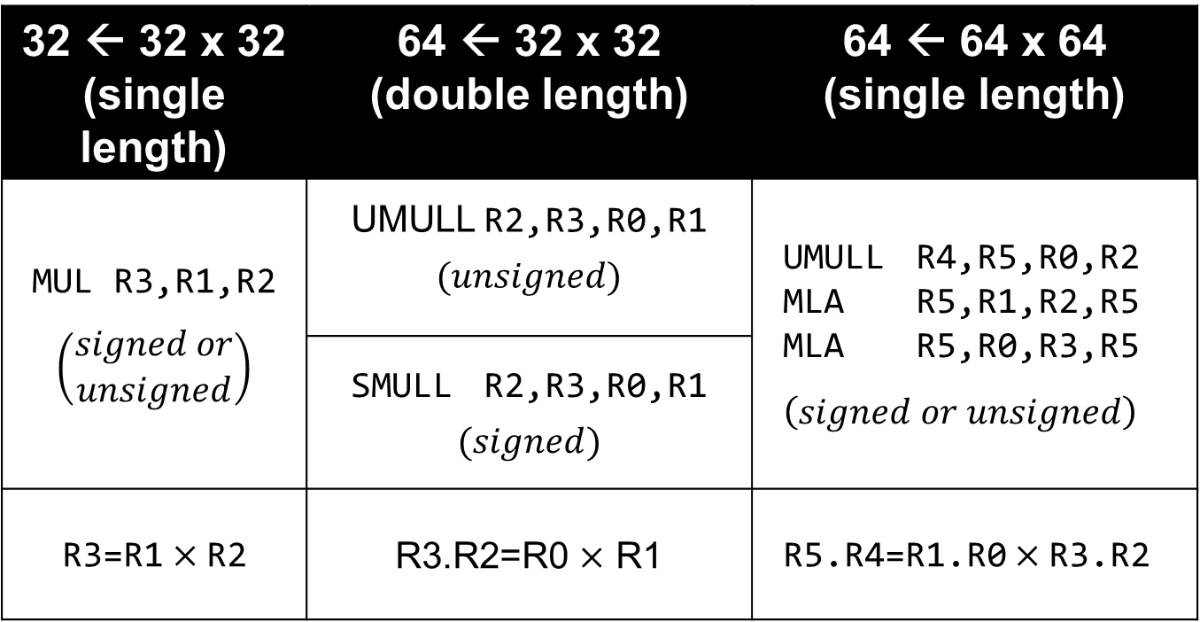
Multiplication Summary
32 ← 32 x 32 (single length) | 64 ← 32 x 32 (double length) | 64 ← 64 x 64 (single length)
MUL R3,R1,R2 $$\left(\begin{aligned}signed or \\ unsigned\end{aligned}\right)$$ | UMULL R2,R3,R0,R1 $$(unsigned)$$ | UMULL R4,R5,R0,R2 MLA R5,R1,R2,R5 MLA R5,R0,R3,R5 $$\left(signed or unsigned\right)$$
 | SMULL R2,R3,R0,R1 $$(signed)$$
R3=R1$×$R2 | R3.R2=R0 $×$ R1 | R5.R4=R1.R0$×$R3.R2

Slide 25
Chapter 5 Integer Arithmetic
Part 3: Division

Slide 26
DIVISION IN C
Consider how integer division works in C:
int8_t a8;
int16_t b16;
int32_t c32;
int64_t d64;
... = a8 / b16;
... = d64 / c32;
All integer divisions produce either a single 32÷32 instruction, or else a library function call for 64÷64.
8 and 16-bit operands are promoted to 32 bits; this becomes a single 32÷32 divide instruction that produces a 32-bit quotient.
c32 is promoted to 64 bits to match d64; this becomes a library function call for 64÷64 division that returns a 64-bit quotient.

Slide 27
SINGLE-LENGTH DIVISION
Unsigned:
2’s complement:
240₁₀
÷4₁₀
60₁₀
1111 0000₂
÷0000 0100₂
(-16₁₀)
÷(+4₁₀)
-4₁₀
Two different instructions for signed vs unsigned division.
0011 1100₂
1111 1100₂
Instruction | Format | Operation
Unsigned Divide | UDIV R_{d},R_{n},R_{m} | R_{d} = (uint32_t) R_{n} ÷ R_{m}
Signed Divide | SDIV R_{d},R_{n},R_{m} | R_{d} = (int32_t) R_{n} ÷ R_{m}

Slide 28
DIVISION OVERFLOW
Overflow during division =>
the result exceeds the quotient’s range.
The smaller range of a single-length dividend reduces the # of operand combinations that result in an overflow.
Two possibilities:
Unsigned or 2's complement: Division by zero
2's complement: Full-scale negative (-2³¹) divided by -1,
There is no hardware detection of overflow during integer division! V flag (overflow) is not affected!

Slide 29
Computing A Remainder
remainder = dividend – divisor × quotient
remainder:
// R0 <-- dividend // example = 14
// R1 <-- divisor // example = 3
SDIV R2,R0,R1 // R2 = R0 / R1 // 4 = 14 / 3
MLS R3,R1,R2,R0 // R3 = R0 – (R1*R2) // 2 = 14 – (3*4)
BX LR
Operation | Quotient | Remainder
(+14) ÷ (+3) | +4 | +2
(+14) ÷ (-3) | -4 | +2
(-14) ÷ (+3) | -4 | -2
(-14) ÷ (-3) | +4 | -2

Slide 30
Chapter 5 Integer Arithmetic
Part 4: Summary of Integer Arithmetic Instructions

Slide 31
Integer Addition
Instructions: ADD{S}, ADC{S}
Format Examples:
ADD R0,R1,#5 // R0 = R1 + 5
ADD R0,R1,R2 // R0 = R1 + R2
ADD R0,R1,R2,LSL #2 // R0 = R1 + (R2 << 2)
Flags: Append “S” to capture result characteristics in NCVZ
Overflow:
Unsigned: Carry Flag (C) = 1
Signed: Overflow Flag (V) = 1 (Set when C_{N}≠C_{N-1})
Multiple precision addition: ADDS → ADC

Slide 32
Integer Subtraction
Instructions: SUB{S}, SBC{S}, RSB{S}
Format Examples:
SUB R0,R1,#5 // R0 = R1 - 5
SUB R0,R1,R2 // R0 = R1 - R2
SUB R0,R1,R2,LSL #2 // R0 = R1 - (R2 << 2)
Flags: Append “S” to capture result characteristics in NCVZ
Overflow:
Unsigned: Carry Flag (C) = 0
Signed: Overflow Flag (V) = 1 (Set when C_{N}≠C_{N-1})
Multiple precision subtraction: SUBS → SBC

Slide 33
Single-Length 32x32 Integer Multiplication
Instructions: MUL{S}, MLA, MLS
Signed vs. Unsigned: Use same instruction
Format Examples:
MUL R0,R1,R2 // R0 = R1 × R2
MLA R0,R1,R2,R3 // R0 = R3 + R1 × R2
MLS R0,R1,R2,R3 // R0 = R3 - R1 × R2
Flags: Append “S” (only MUL) to capture result characteristics in N and Z flags
Overflow: May happen but impossible to detect!

Slide 34
Double-Length 32x32 Integer Multiplication
Instructions: UMULL, SMULL, UMLAL, SMLAL
Signed vs. Unsigned: Use different instructions!
Signed Instruction Formats:
SMULL R0,R1,R2,R3 // R0.R1 = R2 × R3
SMLAL R0,R1,R2,R3 // R0.R1 = R0.R1 + R2 × R3
Unsigned Instruction Formats:
UMULL R0,R1,R2,R3 // R0.R1 = R2 × R3
UMLAL R0,R1,R2,R3 // R0.R1 = R0.R1 + R2 × R3
Flags: Unaffected!
Overflow: Can’t happen

Slide 35
Single-Length 32÷32 Integer Division
Instructions: SDIV, UDIV
Signed vs. Unsigned: Use different instructions!
Signed Instruction Format:
SDIV R0,R1,R2 // R0 = R1 ÷ R2
Unsigned Instruction Format:
UDIV R0,R1,R2 // R0 = R1 ÷ R2
Flags: Unaffected
Overflow:
Division by zero
Full-scale negative divided by -1

Slide 36
Done

